Slide 1
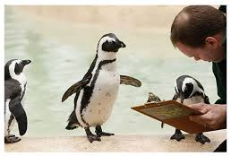
Closing Clusters
Would you say you are extremely cute, very cute, cute, or strikingly handsome?
The Whole Team

Slide 2
What?
Why?
When?
Who?
How?
Finishing and closing work in a cluster
All data must be checked while still in the cluster (if problems, fix while there)
Before leaving the cluster
The whole team works together
Supervisor makes lists of errors, works with team to resolve

Slide 3
Fieldwork Flow – Closing Clusters
Arrive in cluster, Identify households
Interviewers carry out module interviews, collect height/weight
Supervisor assigns households
Interviewers send data to supervisor
Interview HHs, identify eligible individuals
Team resolves structural problems
Interviewer A assigns modules to Interviewer B
Supervisor submits data to central office
Notes:
Quick look at the flow of field work from start to finish in a cluster – training will refer back to this chart regularly

Slide 4

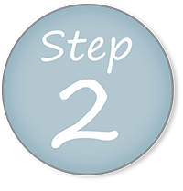


Transfer all team data to supervisor, one interviewer at a time
Supervisor attempts to close cluster, makes listing of all outstanding errors
Identify where error is and resolve all
Once resolved, Supervisor closes and sends data to Central Office (via Dropbox)

Slide 5
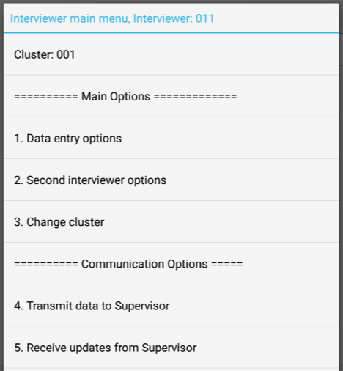

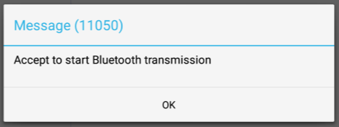
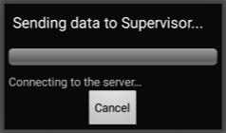
Interviewer prepares to send data
REVIEW
From interviewer main menu, choose option 4:

Slide 6
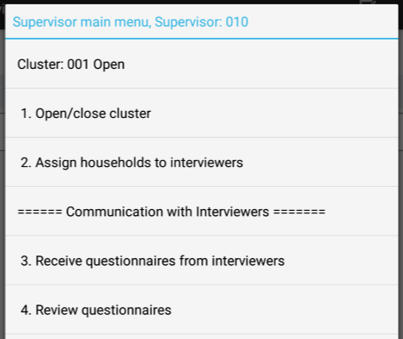

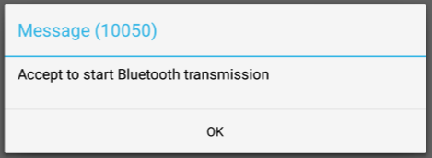
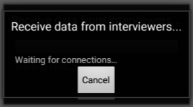
Supervisor prepares to receive data
REVIEW
From supervisor main menu, choose option 3:

Slide 7
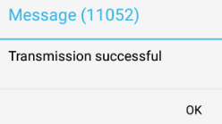
Interviewers send data
REVIEW
One at a time!!
Notes:
Repeat process for each interviewer, one at a time!

Slide 8
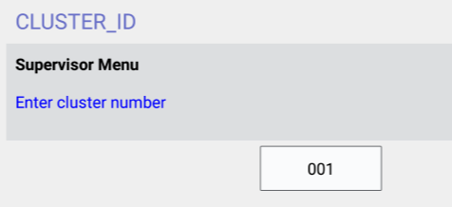
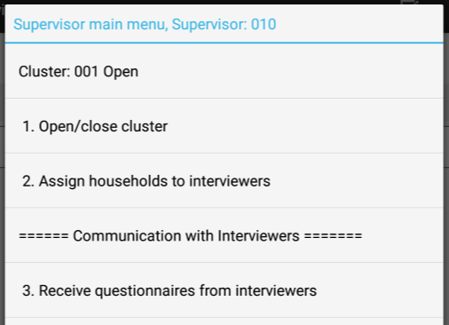
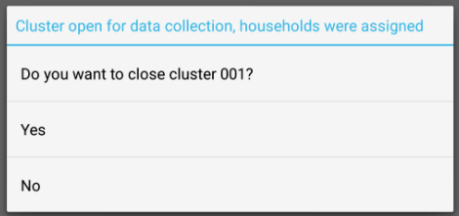

Closing clusters listing
Supervisor chooses option 1 from main menu:
Notes:
Enter cluster number (leading 0’s not necessary).

Slide 9
Closing clusters listing
Listing will show three parts:
Error message numbers – help find in manual
Error messages – brief description of problem
Household listing – a list of all households, modules, women, and children in cluster, and their results codes

Slide 10
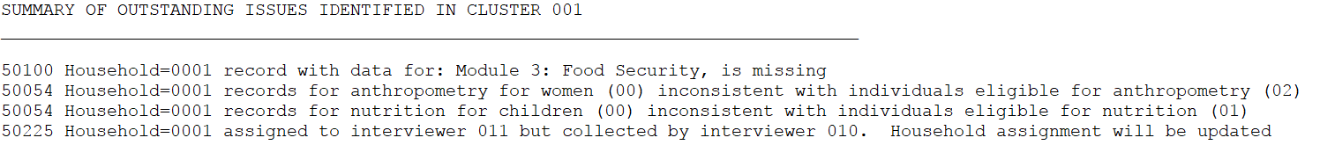
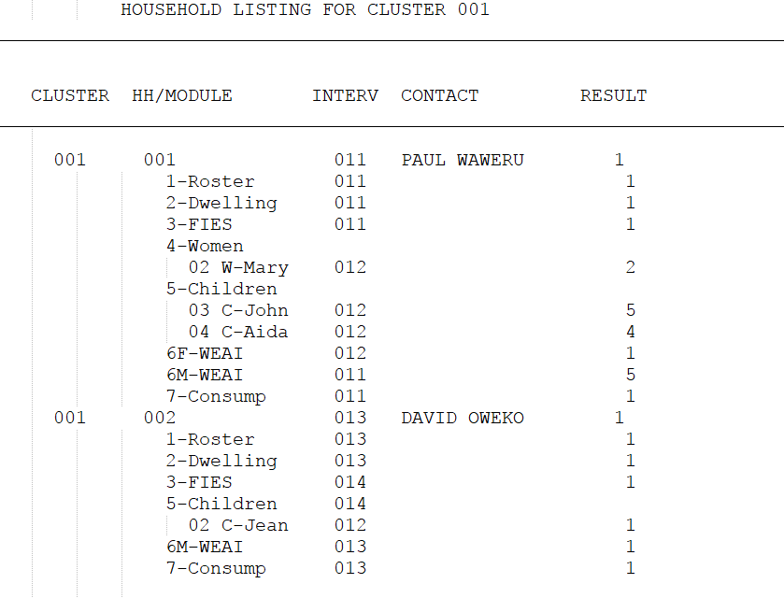
Closing clusters listing
1
2
Error message numbers
Error messages
Household listing
3
Notes:
Supervisor will something that looks like this…

Slide 11
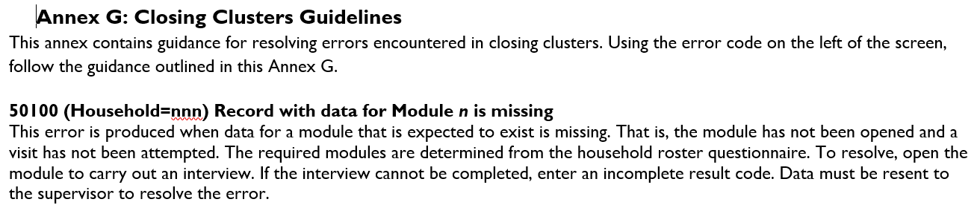
Resolve errors…
Identify error number and find it in the Supervisor Manual (Appendix G)
Error number, message found in report
Notes:
Error number (1 in previous slide) is circled.

Slide 12
Resolve errors…
Identify which interviewer(s) has the problem
Household 001 has error → Household 001 belongs to interviewer 011
Notes:
Find which interviewer has the error by finding the household in the listing and seeing which interviewer did it…

Slide 13

Resolve errors…
Refer to Supervisor Manual (Appendix C) for instructions to resolve
Interviewer resends data to supervisor
Supervisor attempts again to close cluster – determine if error was resolved
Now for some common errors…............

Slide 14
Common errors…
50203 (Household=nnn) One or more mandatory modules is missing
50100 (Household=nnn) Record with data for Module n is missing
Notes:
Have teams find this error in the superv manual. Have someone read it to the class. Have someone else explain what to do….

Slide 15
Common errors…
50054 Number of women/children eligible in household schedule for anthropometry (n) is inconsistent with total number of women/children completed for anthropometry (n)
50055 Household questionnaire partially completed, structure will not be checked at this time
Notes:
Have teams find this error in the superv manual. Have someone read it to the class. Have someone else explain what to do….

Slide 16
Closing Cluster
Are all errors resolved? See a listing like this?
If all errors resolved, then only the household listing (for entire cluster) remains
Notes:
Close the listing….

Slide 17
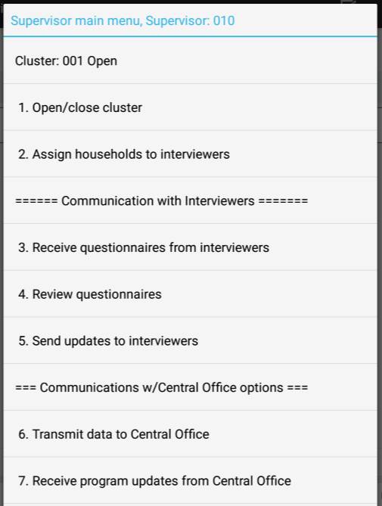

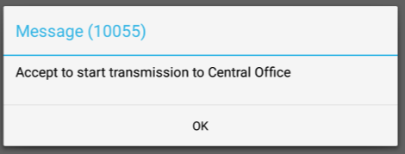
Supervisor sends team data
REVIEW
From supervisor main menu, choose option 6:
Notes:
GD TO DO – missing Bluetooth message box because Dropbox isn’t compatible at the moment…

Slide 18
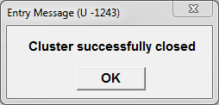
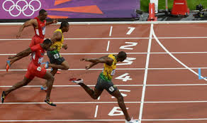

Closing Cluster
… can now move to next cluster…

